Slide 1

BCS786 Major Project Phase-II
Review 3
Batch No.- PROJECT TITLE
By
NAME - USN
NAME - USN
Under the Guidance of
Guide Name
Designation

Slide 2
BIRD VIEW
PROJECT TITLE
2025 - 26
Introduction
Motivation
Abstract
Literature Survey
Comparative analysis of the survey
Problem Statement
Proposed System
System Requirements (Hardware & Software Requirements)
Methodology (System Architecture & Dataflow Diagram)
Module Description (System Architecture, Data flow diagram, Sequence diagram, Use case diagram)
Implementation Progress (Partial code, code snippets of the UI/Backend developed so far)
Future work
References
1

Slide 3
INTRODUCTION
2025 - 26
PROJECT TITLE
Autonomous Smart Campus Ecosystem: SmartCampus AI is an enterprise-grade, privacy-centric campus automation platform designed to automate multi-student classroom attendance, academic scheduling, and operations using standard 1080p CCTV infrastructure.
Deep-Learning Computer Vision Pipeline: Integrates a multi-stage vision pipeline featuring SCRFD 10G face detection with adaptive multi-scale ROI upscaling (for distant back-row faces), temporal IoU tracking, MediaPipe quality filtering, and 512-D ArcFace embeddings.
Zero-Friction Unsupervised Enrollment: Replaces tedious manual photo registration with automated HDBSCAN track-level clustering and multi-evidence consolidation, discovering and enrolling student facial profiles directly from video sessions.
Sub-Millisecond Vector Search & Indexing: Employs an on-premise FAISS (Facebook AI Similarity Search) cosine vector index for real-time biometric verification and proxy prevention with zero cloud reliance.
Decoupled Monorepo Architecture: Engineered with a Next.js 16 (React 19) web dashboard, NestJS 10 REST/WebSocket API gateway, FastAPI Python AI service, PostgreSQL database (Prisma ORM), Redis session caching, and MinIO storage.
2

Slide 4
MOTIVATION
2025 - 26
PROJECT TITLE
Eliminating Instructional Lecture Time Loss: Traditional manual roll calls consume 10–15% (5–10 minutes) of every lecture, resulting in hundreds of wasted teaching hours across semesters.
Preventing Proxy Attendance & Record Manipulation: Conventional paper registers, sign-in sheets, and RFID card swipes suffer from widespread proxy marking ("buddy punching") and human logging errors.
Resolving Inequitable Back-Row Face Recognition: Standard face recognition algorithms fail on back-row students due to extreme distance, low resolution (20–35 px), perspective shrinkage, and occlusions.
Overcoming High Administrative Enrollment Overhead: Manually collecting and uploading biometric headshots for thousands of students is tedious and unscalable; automated video clustering streamlines onboarding.
Ensuring Strict Biometric Privacy & Data Sovereignty: Third-party cloud vision APIs create severe data privacy vulnerabilities and recurring costs; an on-premise local vector architecture guarantees complete security.
3

Slide 5
ABSTRACT
2025 - 26
PROJECT TITLE
In paragraph
3

Slide 6
LITERATURE SURVEY - 1
2025 - 26
PROJECT TITLE
8 to 10 survey papers
4

Slide 7
COMPARATIVE ANALYSIS
2025 - 26
PROJECT TITLE
Reference | Algorithm/ Technique | Platform used | Performance Metrics | Advantage | Drawback
[1]
[2]
[3]
[4]
Slide no

Slide 8
PROBLEM STATEMENT
2025 - 26
PROJECT TITLE
Pedagogical Inefficiency of Manual Attendance: Manual roll-call and paper register processes in large university classrooms (60+ students) cause substantial academic disruptions, delays, and administrative overhead.
Vulnerability to Proxy Attendance & Falsification: Existing attendance recording methods lack continuous, non-repudiable biometric validation, enabling student proxy attendance and unverifiable attendance logs.
Severe Perspective & Scale Degradation in CCTV Feeds: Single-camera classroom video feeds suffer from acute scale variance, low-pixel facial crops in back rows, dynamic head poses (yaw/pitch), and frequent occlusions.
Infeasibility of Supervised Biometric Registration: Traditional facial recognition systems mandate controlled, single-person photo enrollment setups that cannot scale efficiently across entire university batches.
Lack of Integrated Real-Time Telemetry & Risk Analytics: Existing standalone attendance solutions fail to provide unified role-based workflows, live session telemetry, automated absentee risk prediction, and tamper-proof audit trails.
3

Slide 9
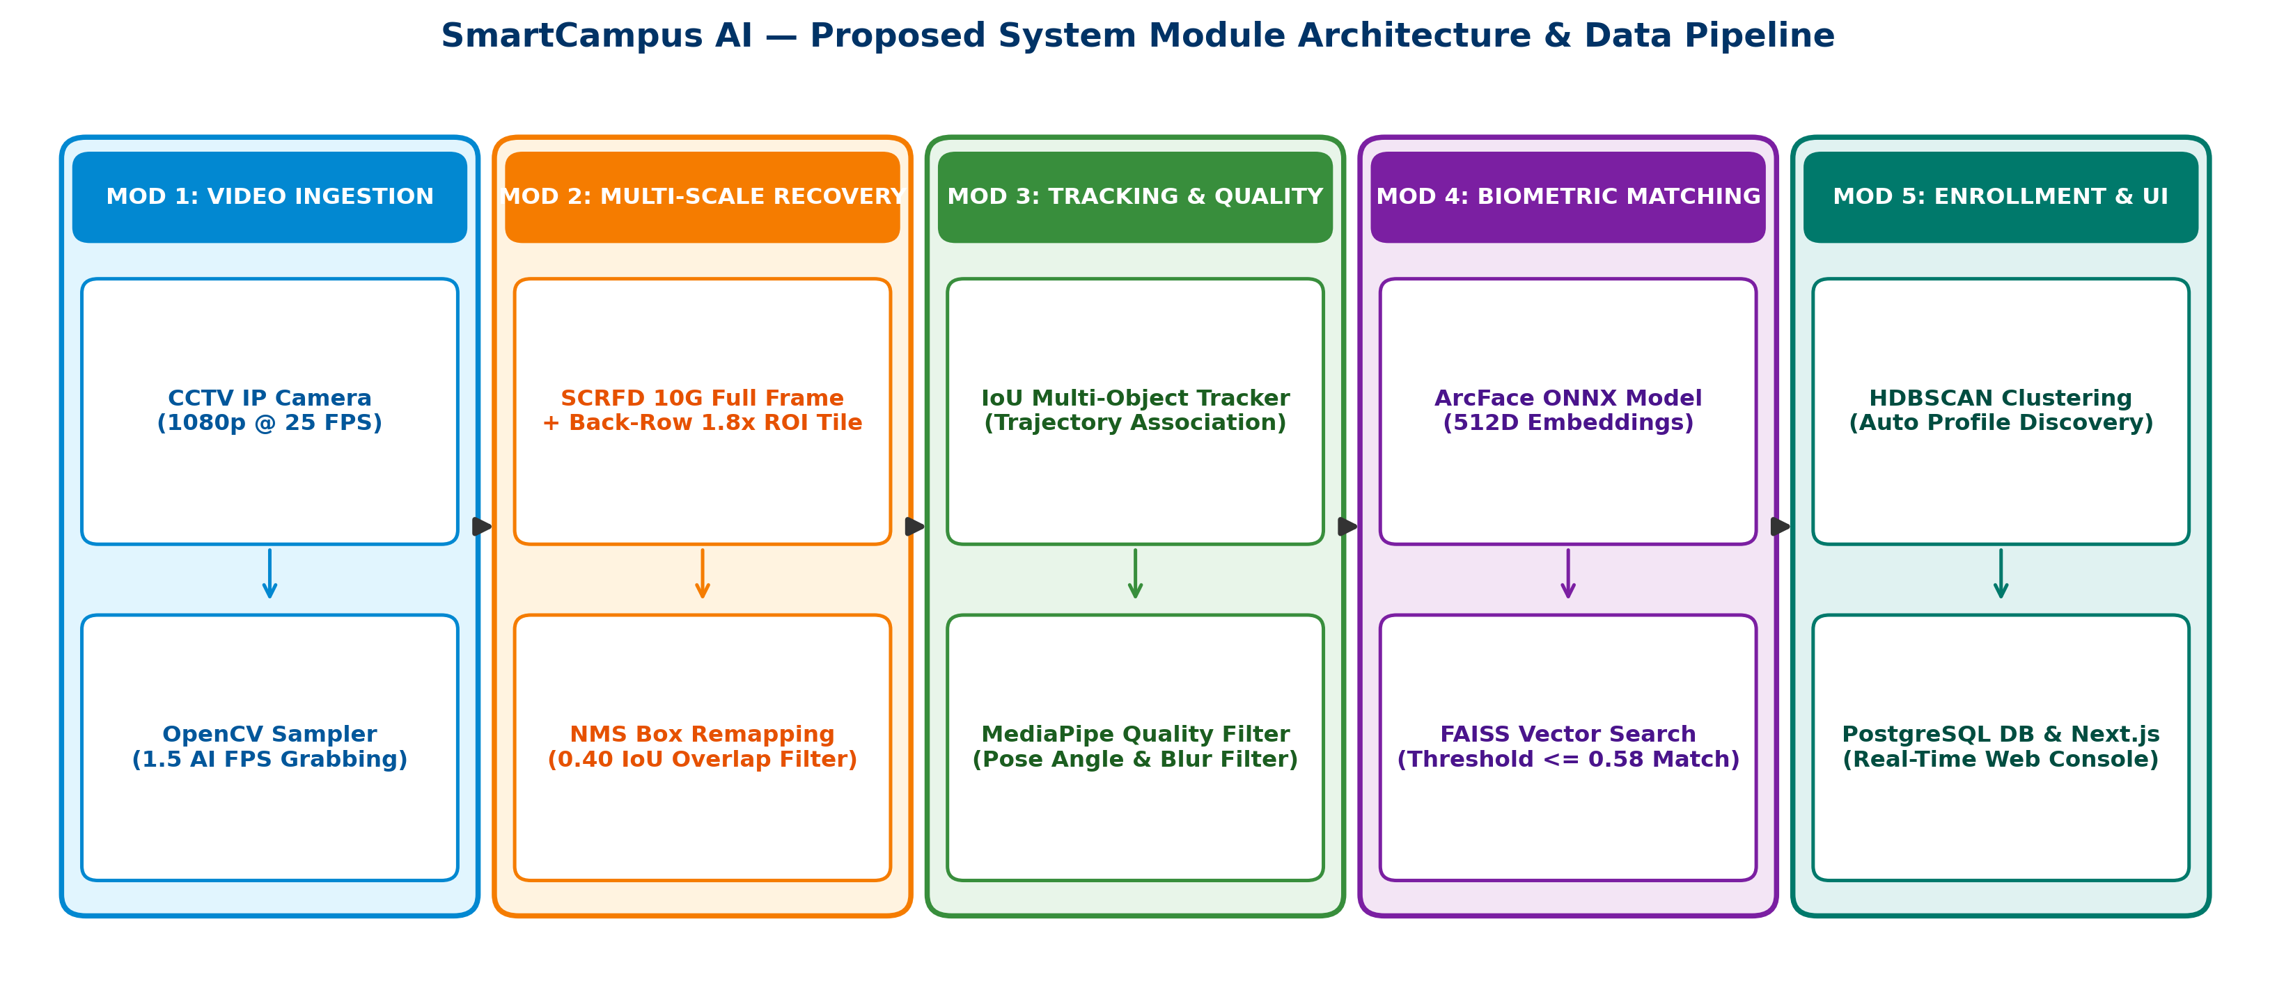
PROPOSED SYSTEM
2025 - 26
PROJECT TITLE
3

Slide 10
SYSTEM REQUIREMENTS (HARDWARE & SOFTWARE REQUIREMENTS)
2025 - 26
PROJECT TITLE
HARDWARE REQUIREMENTS:
  Processor (CPU): Multi-Core Intel Core i7 / Xeon or Apple Silicon M-Series (M1/M2/M3/M5) (8+ Cores).
  System Memory (RAM): Minimum 16 GB DDR4/DDR5 Unified Memory (32 GB recommended for multi-stream AI processing).
  GPU / Acceleration (Optional): NVIDIA RTX 3060/4070 or Apple Neural Engine / Metal for ONNX Runtime acceleration.
  Storage: 512 GB NVMe Solid State Drive (SSD) for high-speed video frame buffers, crop storage, and databases.
  Camera Infrastructure: Fixed Classroom CCTV IP Cameras (1080p Full HD @ 25 FPS, RTSP / H.264 video streaming).
SOFTWARE REQUIREMENTS:
  Operating System: macOS 14+, Linux (Ubuntu 22.04 LTS), or Microsoft Windows 11.
  Core Runtimes: Python 3.12+ (AI Service Engine), Node.js v20+ / TypeScript (Web Console & API Gateway).
  AI & Vision Libraries: OpenCV, InsightFace (SCRFD 10G Detector), ArcFace (512D ONNX Model), MediaPipe Face Landmarker.
  Vector Search & ML Tools: FAISS (Facebook AI Similarity Search), HDBSCAN (Clustering), NumPy, Scikit-Learn.
  Web & API Frameworks: Next.js 16 (React, TailwindCSS), NestJS 11 (API Gateway), FastAPI (Python Microservice).
  Database & Storage: PostgreSQL 16 with Prisma ORM, Redis (Session Caching), MinIO (S3 Biometric Storage).
3

Slide 11
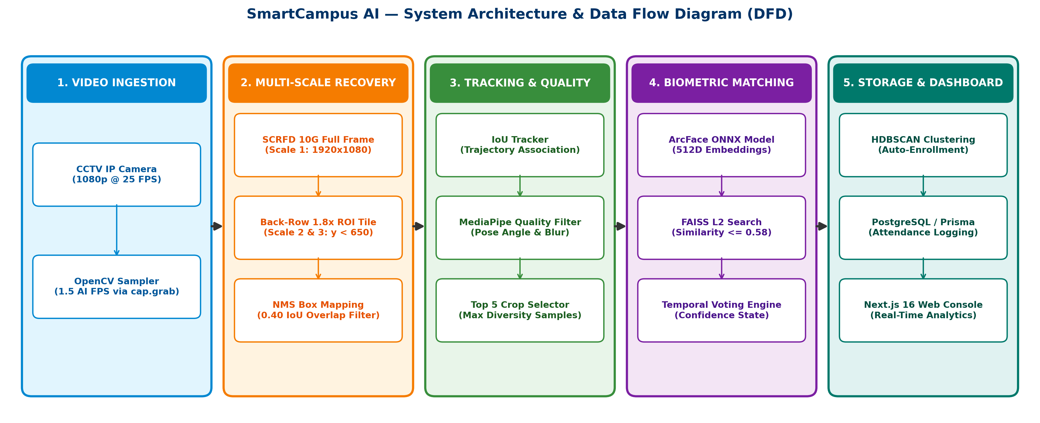
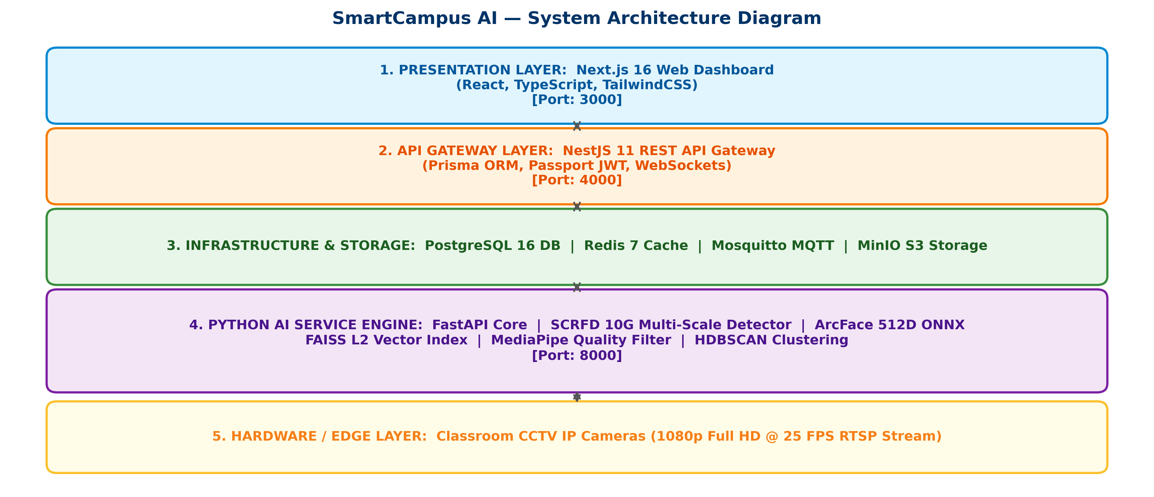
METHODOLOGY (SYSTEM ARCHITECTURE & DATAFLOW DIAGRAM)
2025 - 26
PROJECT TITLE
3

Slide 12
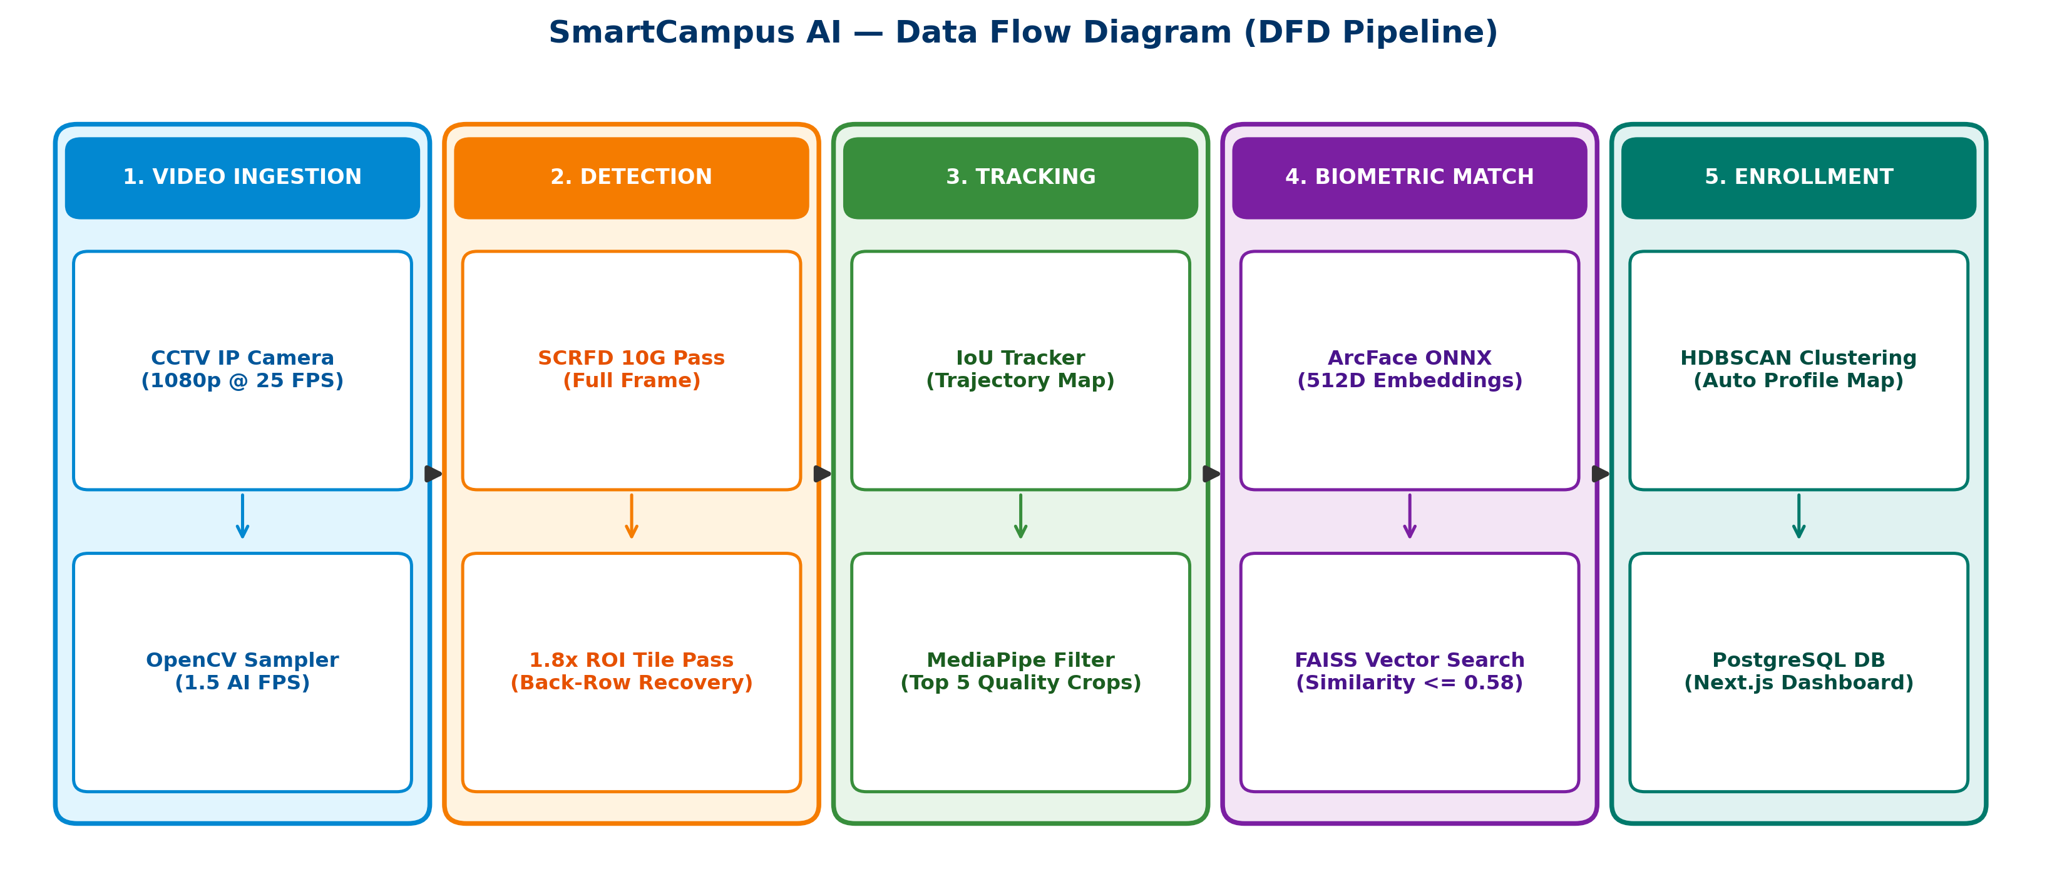
MODULE DESCRIPTION (SYSTEM ARCHITECTURE, DATA FLOW DIAGRAM, SEQUENCE DIAGRAM, USE CASE DIAGRAM)
2025 - 26
PROJECT TITLE
3

Slide 13
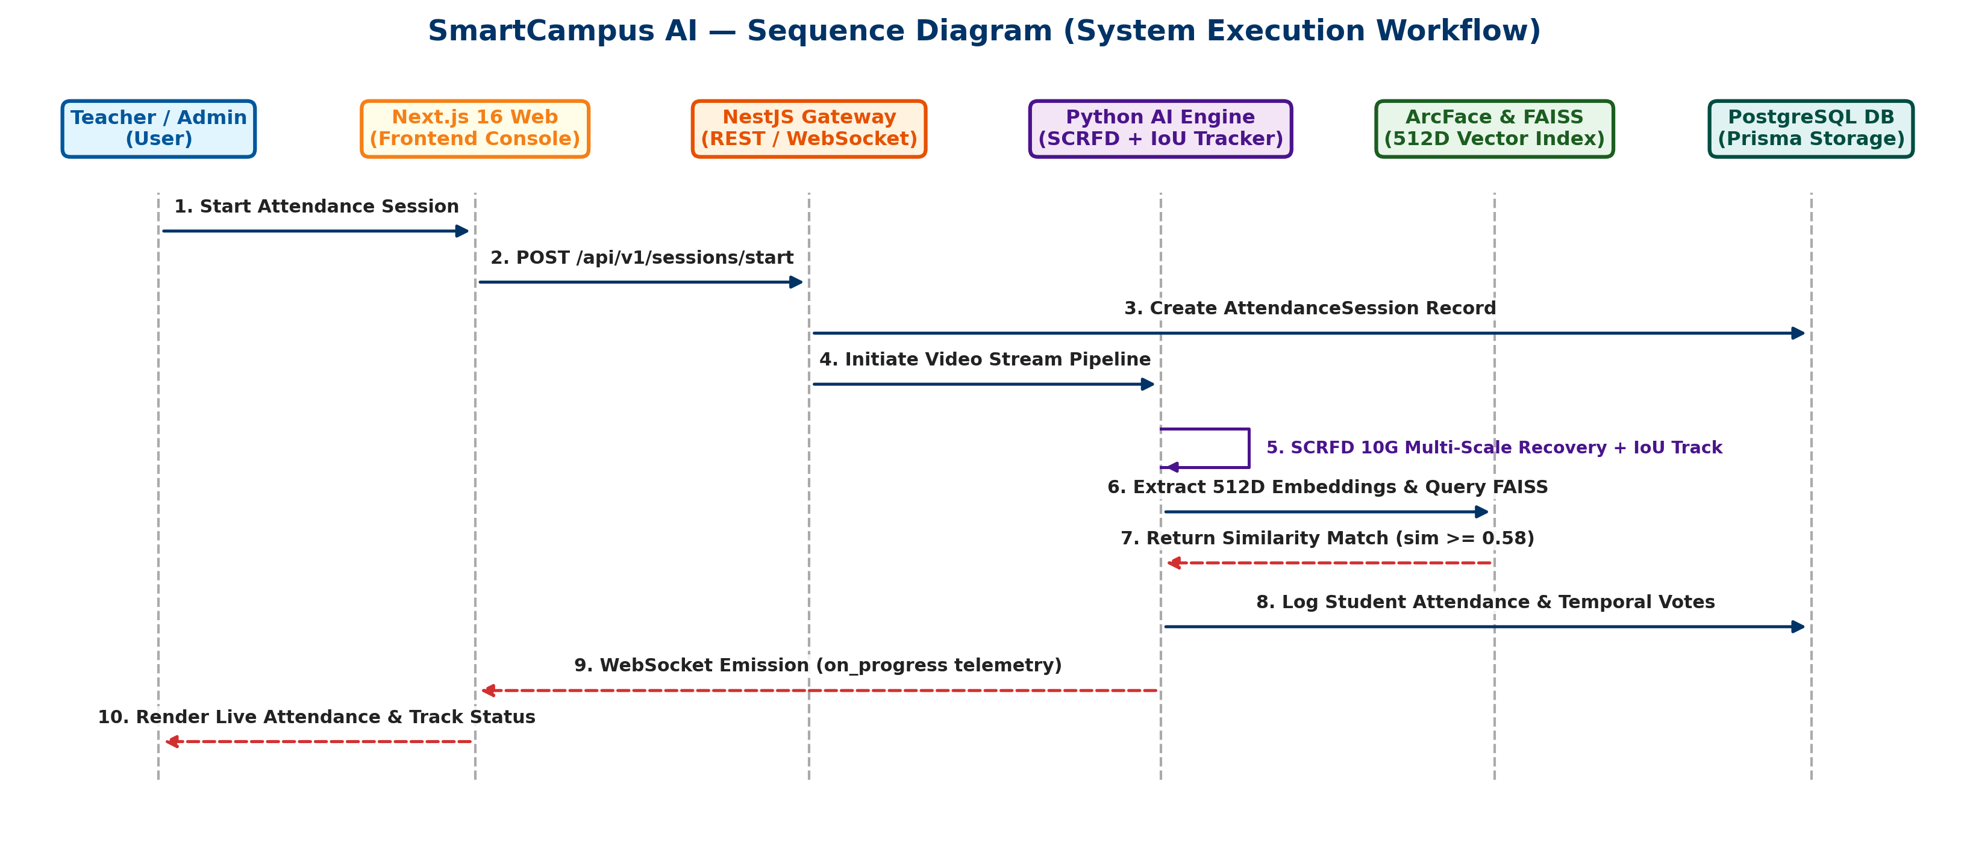
IMPLEMENTATION PROGRESS (PARTIAL CODE, CODE SNIPPETS OF THE UI/BACKEND DEVELOPED SO FAR)
2025 - 26
PROJECT TITLE
1. ADAPTIVE MULTI-SCALE FACE DETECTOR (Python / SCRFD 10G):
  def detect_multiscale_faces(self, frame, force_recovery=False):
  primary_dets = self.detect_faces(frame) # Scale 1: Full Frame SCRFD 10G
  back_row = [d for d in primary_dets if (d['bbox'][1]+d['bbox'][3])/2.0 < 650]
  if len(back_row) < 15 or force_recovery: # Trigger 1.8x ROI Tile Recovery
  roi_tile = cv2.resize(frame[0:650, :], None, fx=1.8, fy=1.8) # Scale 2 & 3
  recovered = self.detect_faces(roi_tile)
  primary_dets.extend(self._remap_and_nms(recovered, scale=1.8, iou_thresh=0.40))
  return primary_dets
2. TRACKING & MEDIAPIPE QUALITY FILTER (Python / MediaPipe Landmarker):
  def consider_sample(self, crop, timestamp, max_samples=5):
  if len(self.selected_samples) >= max_samples: return None # Max 5 Samples/Track
  mp_res = mediapipe_face_quality_service.evaluate_crop(crop)
  if mp_res['is_acceptable']: # Validate Head Pose (-30..+30 deg) & Blur Sharpness
  self.selected_samples.append({'crop': crop, 'quality': mp_res['overall_quality']})
3. ARCFACE 512D & FAISS VECTOR SEARCH (Python / ONNX / FAISS):
  emb = embedding_service.generate_embedding(crop) # 512D L2 Normalized Vector
  match = faiss_service.search_face(emb, threshold=0.58) # Sub-Millisecond Vector Search
4. NEXT.JS 16 DASHBOARD TELEMETRY (TypeScript / React / WebSockets):
  <StatChip icon={ScanFace} label='Detections' value={active.detectedFacesCount} />
  <StatChip icon={Layers} label='Tracks' value={active.totalTracks} />
  <StatChip icon={Fingerprint} label='ArcFace 512D' value={active.arcfaceEmbeddings} />
3

Slide 14
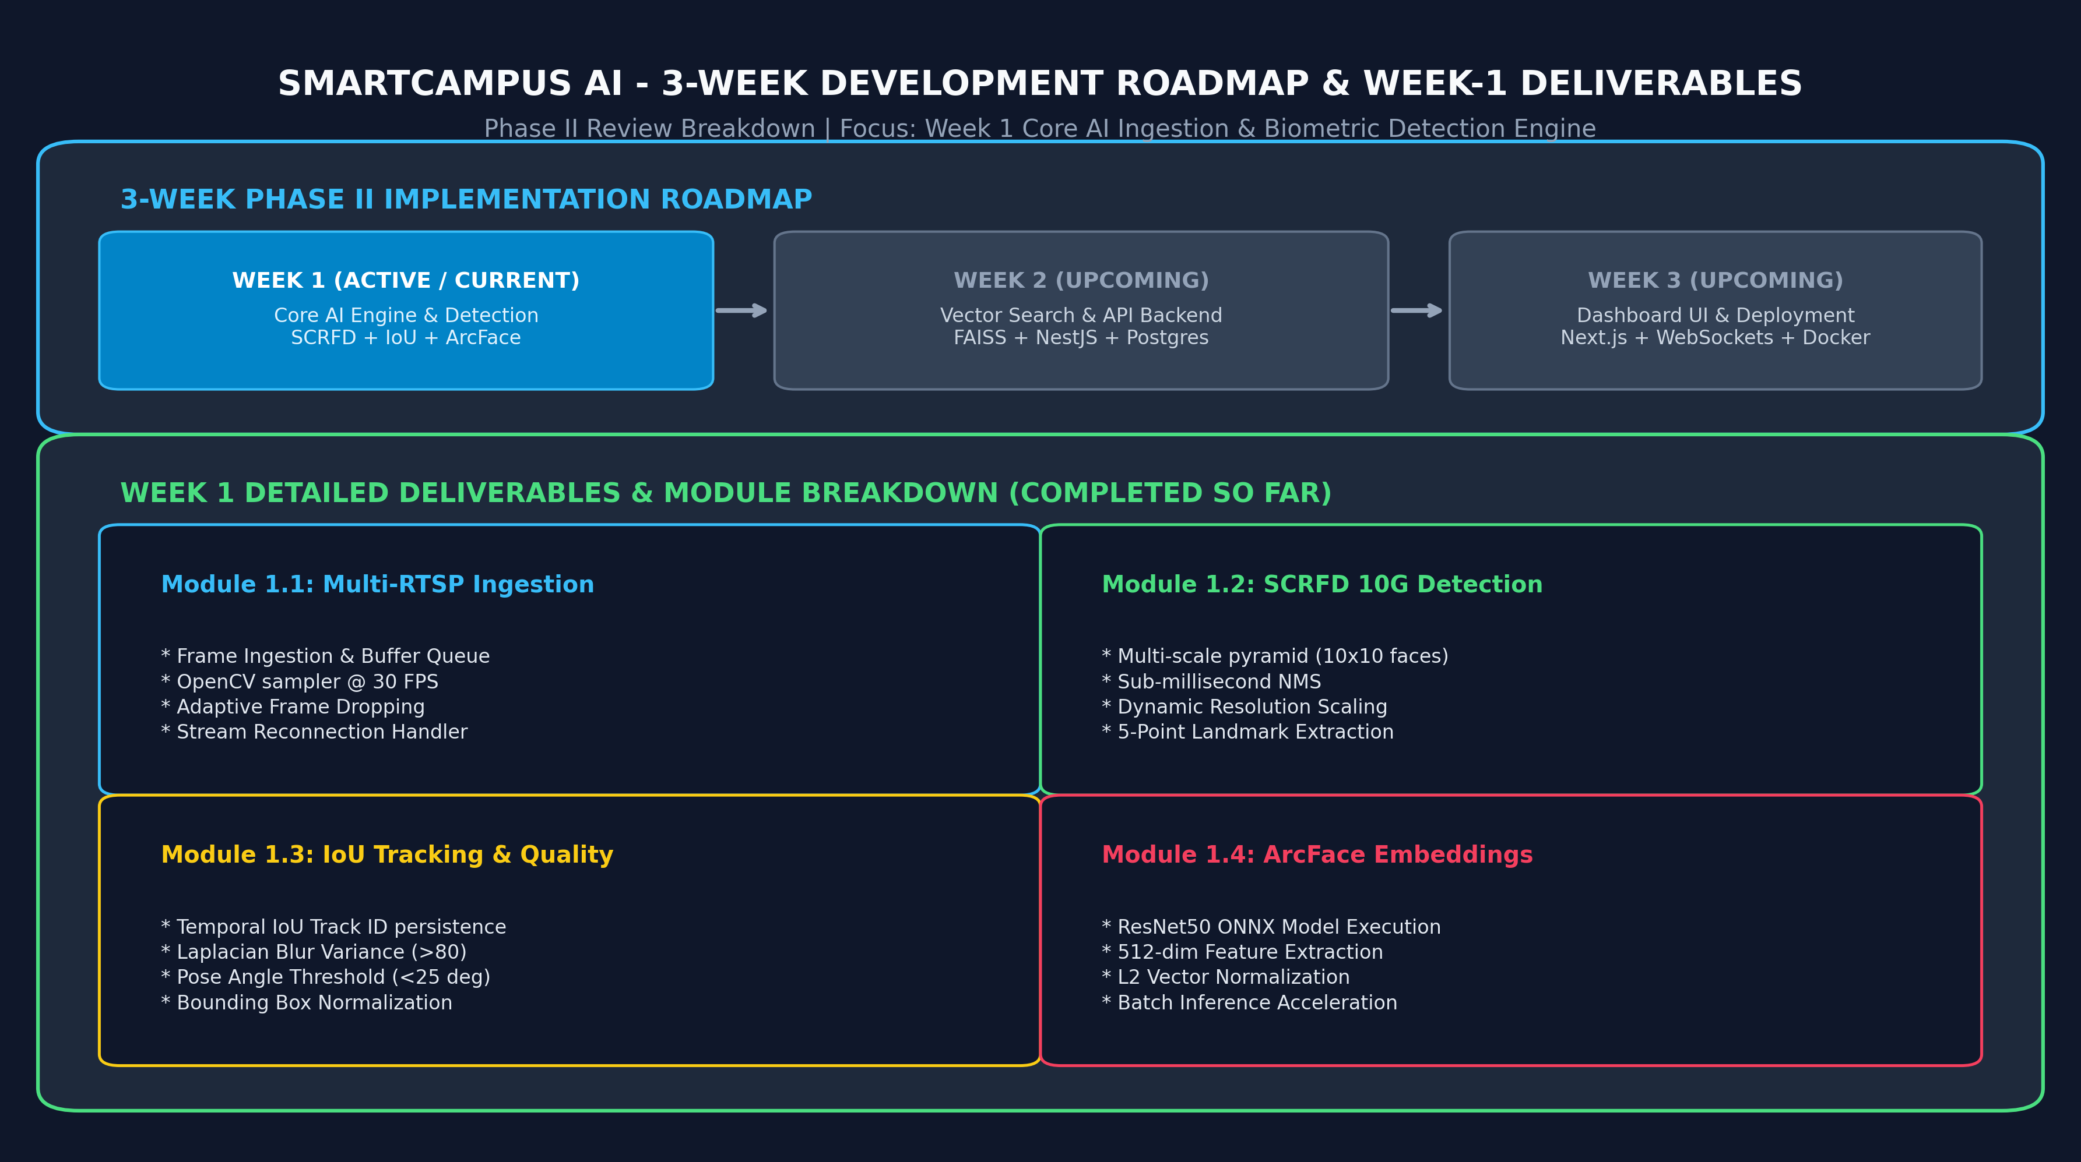
3-WEEK IMPLEMENTATION PLAN & WEEK-1 DELIVERABLES
2025 - 26
PROJECT TITLE
3

Slide 15
REFERENCES
2025 - 26
PROJECT TITLE
Slide no

Slide 16
THANK YOU
2025 - 26
PROJECT TITLE
Slide no

